Slide 1
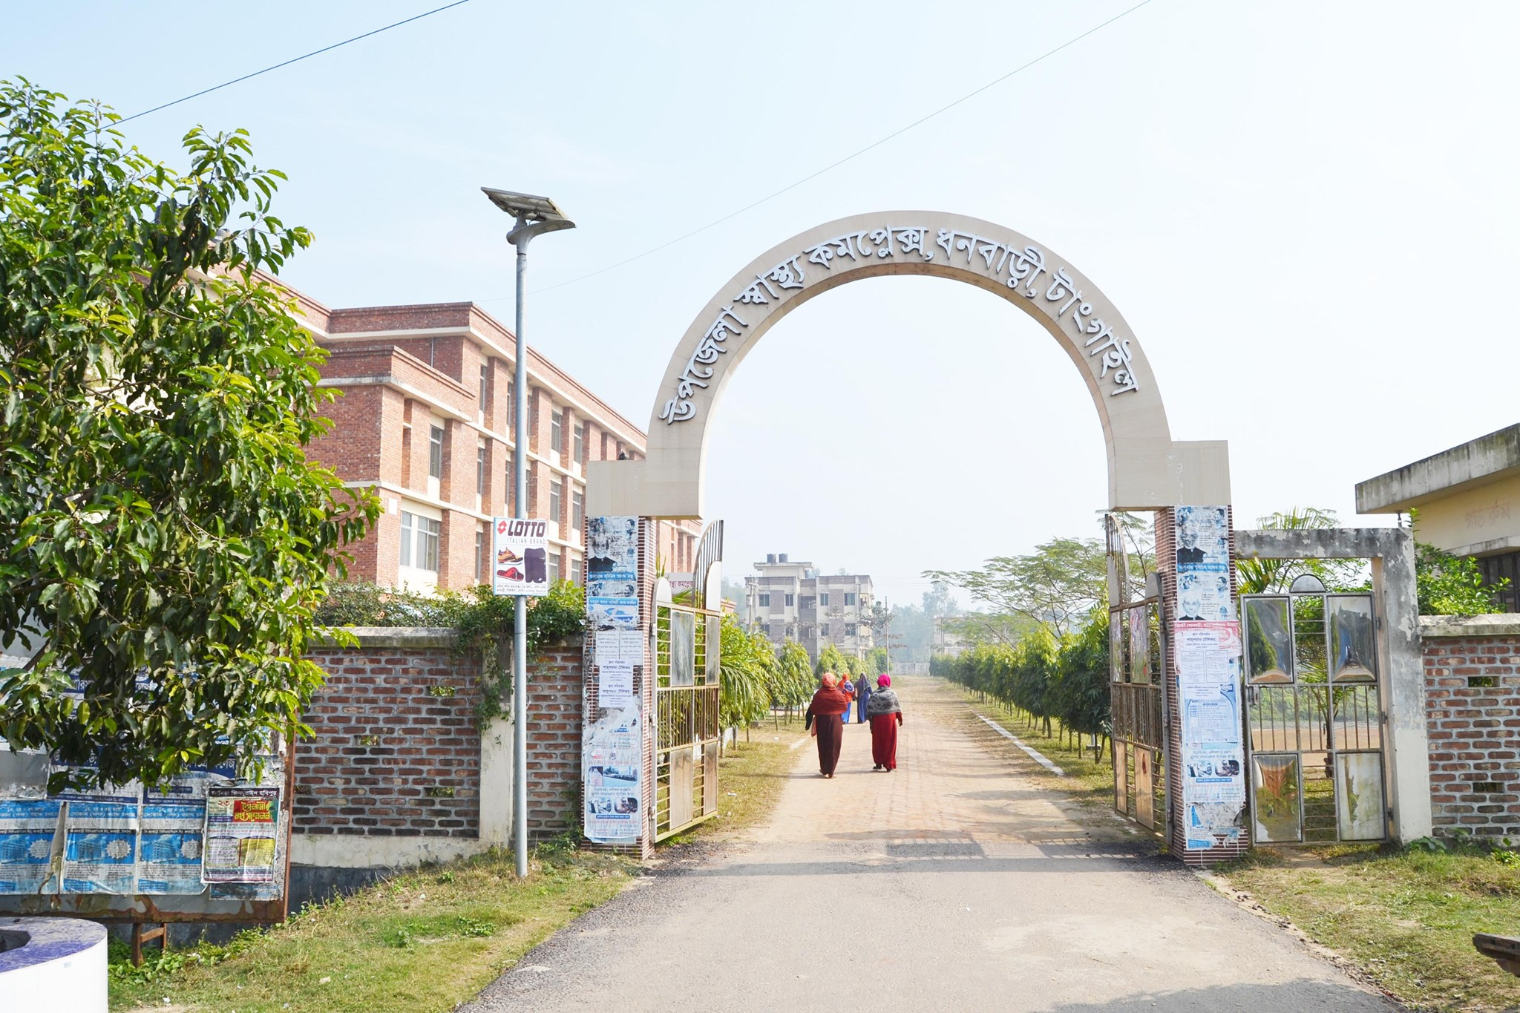

Upazila Health Complex, Dhanbari, Tangail.
Dr. Shahnaz Sultana
UH&FPO, Dhanbari

Slide 2
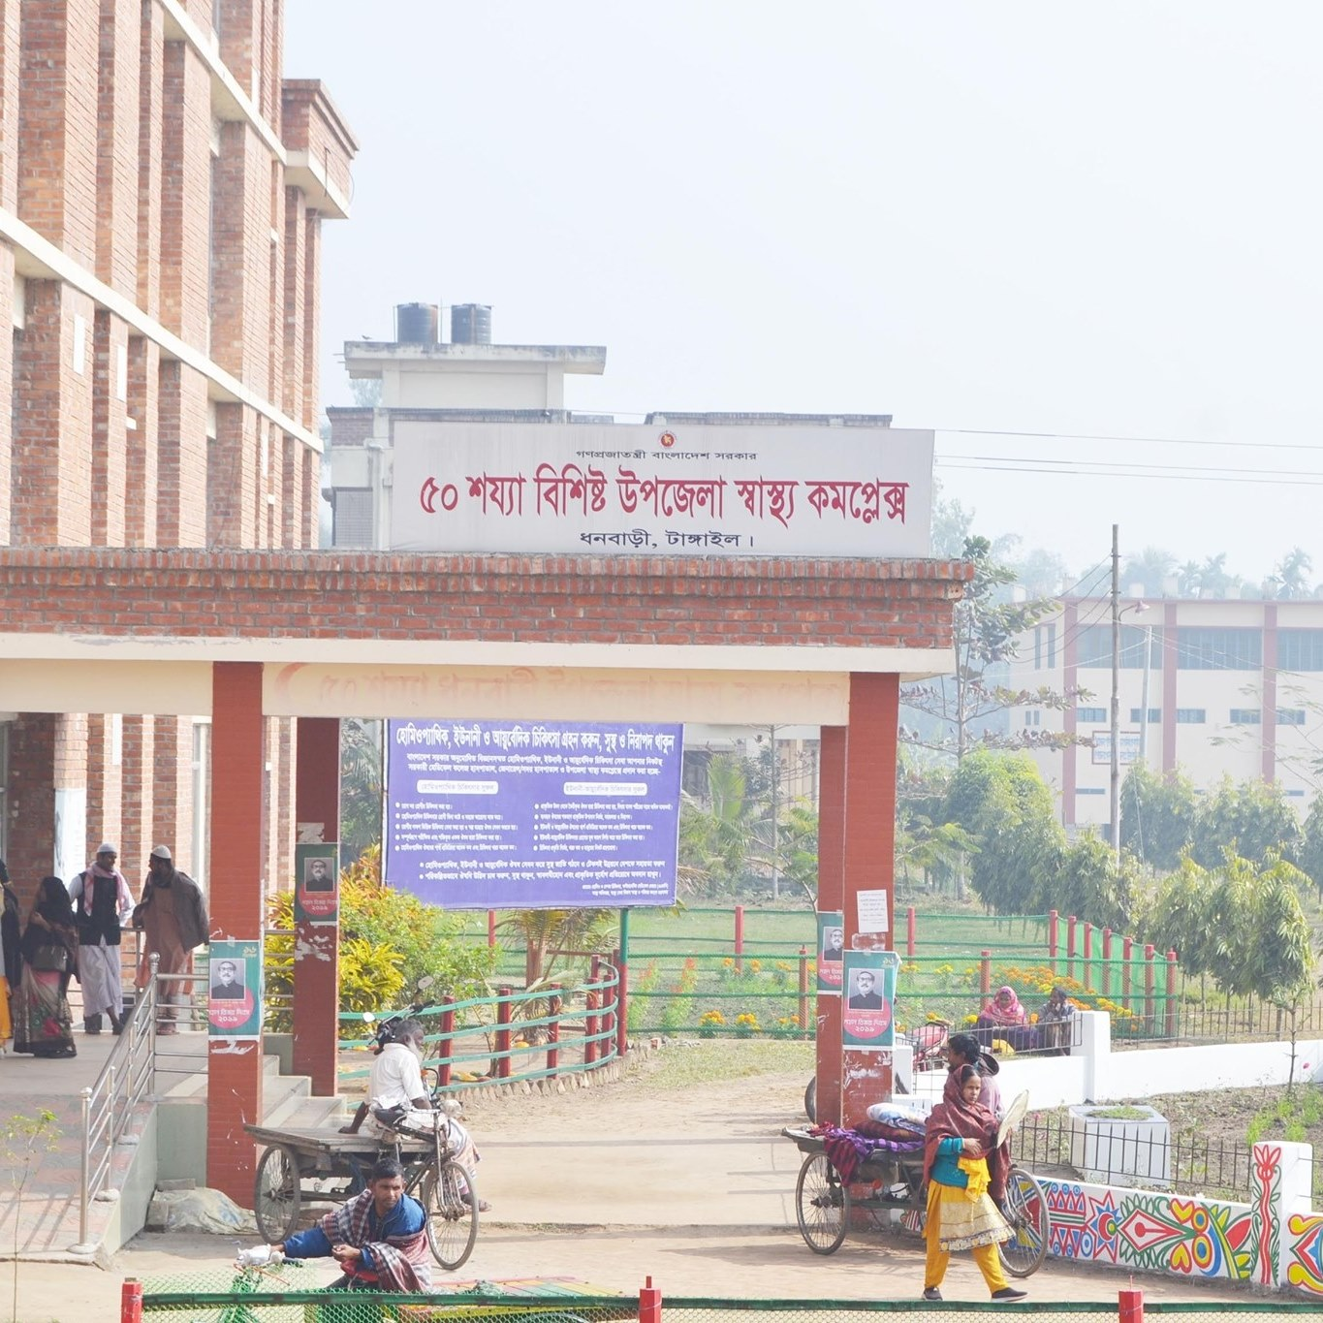
Background History
Established as 50 Bedded UHC in 2015
Outdoor Service Started in 2015.
Indoor Service Started in 2020.
C-Section started in 2021.
SSK Starts in April 2022.

Slide 3
Health Profile of Dhanbari Upazila- 2022
Total Union:
Pourosova
Total Population: 2,09,000
Total Fertile Couple
Total Pregnant Mother
Total Under 5 Children
Health Man Power
Doctor : 21
Nurse: 32
Midwives:5
Medical Technologist
HA: 13
Security Guard & Cleaner: 9
Health Institutions
Health Complex: 01
H & FWC: 05 (Sub-Centre: 2, RD: 2, FWC: 1)
Community Clinic: 20
Non- Govt Clinic: 13

Slide 4
Mother Taken-ANC 1st :
Hospital Delivery Rate :
Total C. Section rate :
No. of Hospital bed : 50
Bed Occupancy Rate :
EPI(MeaselsCoverage) :
Covid-19 ( Imunization Coverage ):
CPR :
TFR :
CBR :
CDR :
Population Growth Rate :
Maternal Mortality Ratio :
Neonatal Mortality Rate :
Infant Mortality Rate :
Under-5 Mortality Rate :

Slide 5
A Hospital with a Vision …
Maximum utilization of Govt.
resources with
honesty and sincerity.
Integrated approach of
Administration, Community
Leaders .
Providing Effective services
through improved
management system.

Slide 6
Bed Occupancy Rate from 2020 to July, 2022

Slide 7
Outdoor And Emergency Patients
From 2020 to July, 2022

Slide 8
Indoor Patient
From 2020 to July, 2022

Slide 9
VIA Screening
From 2020 to July, 2022

Slide 10
ANC 1st & 4th Visit.
From 2020 to July, 2022

Slide 11
Delivery
From 2020 to July, 2022

Slide 12
Total Number of X-Ray and USG Service
From 2020 to July, 2022

Slide 13
Number of TB Patient Treatment
From 2020 to July, 2022

Slide 14
Lab Investigation (User Fee)
From 2020 to July, 2022

Slide 15
Total User Fee
From 2020 to July, 2022

Slide 16
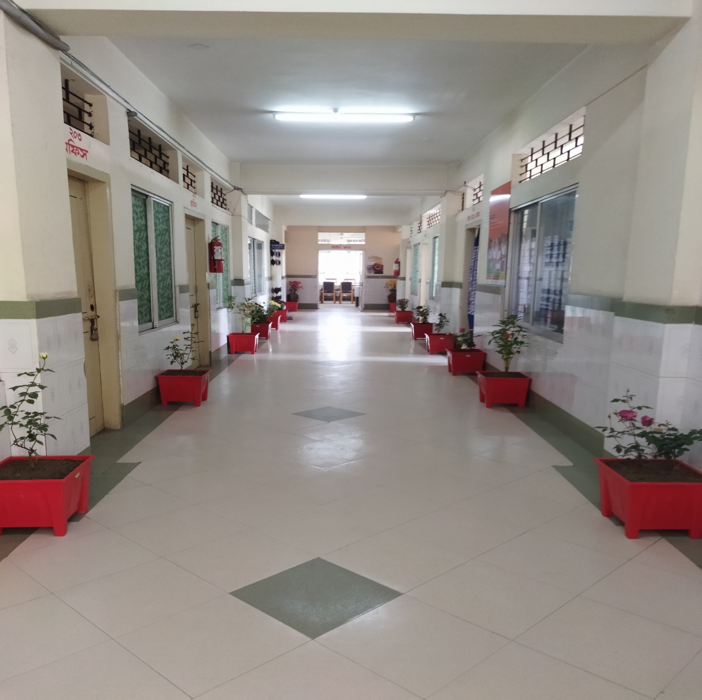
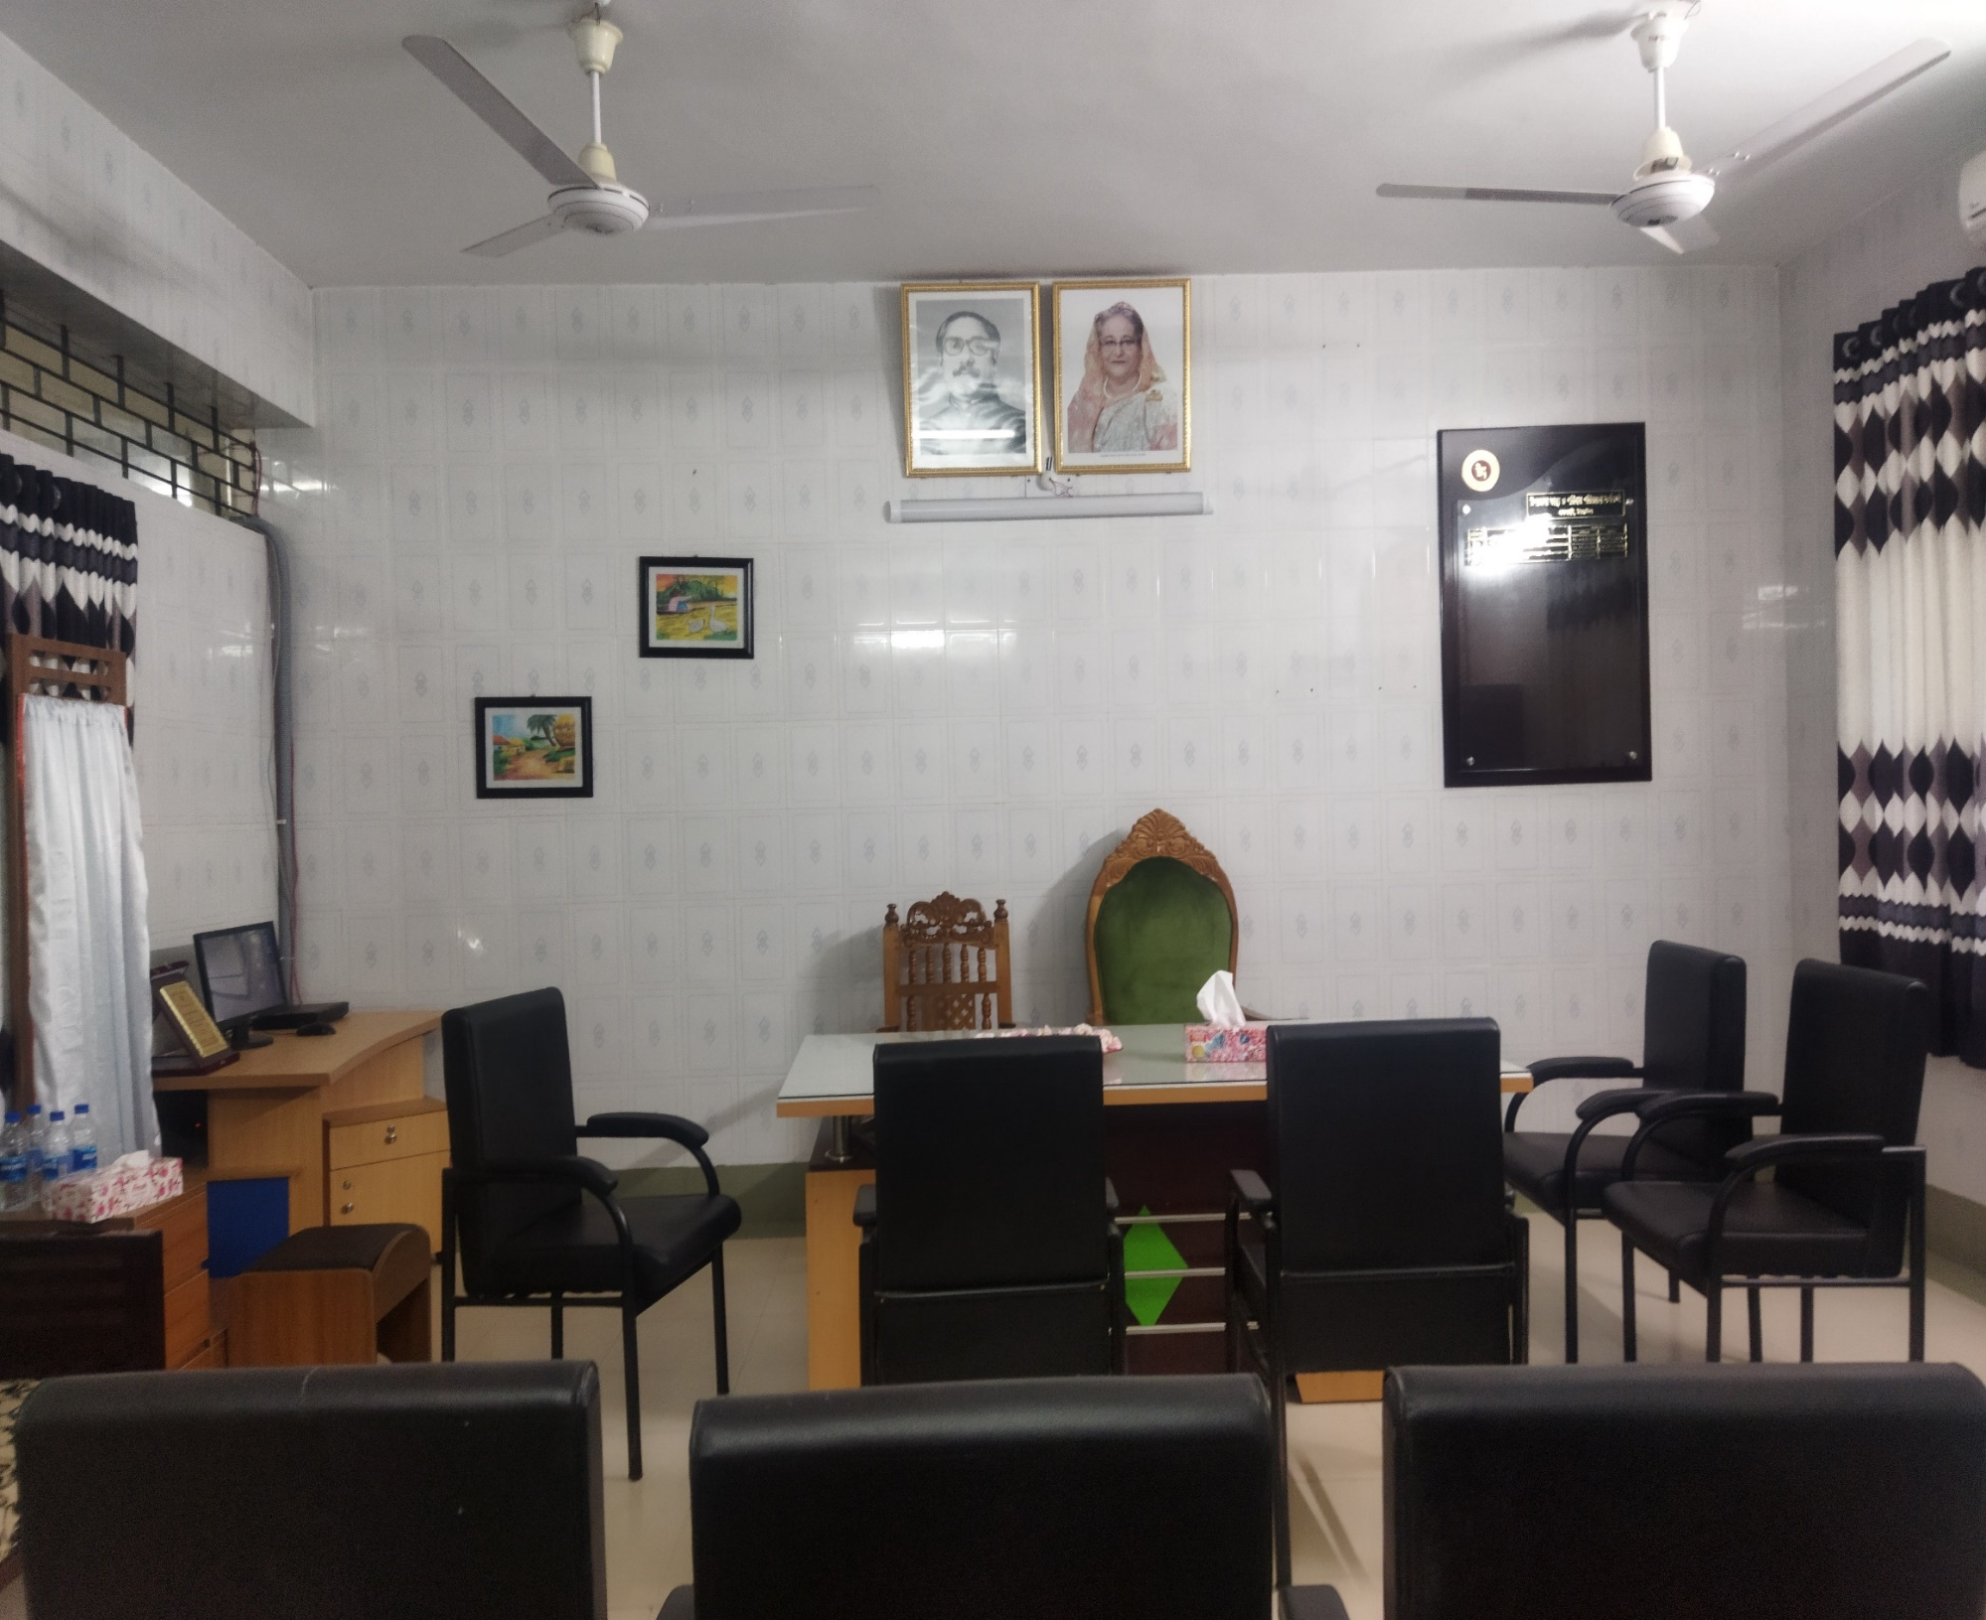
Administrative Unit

Slide 17
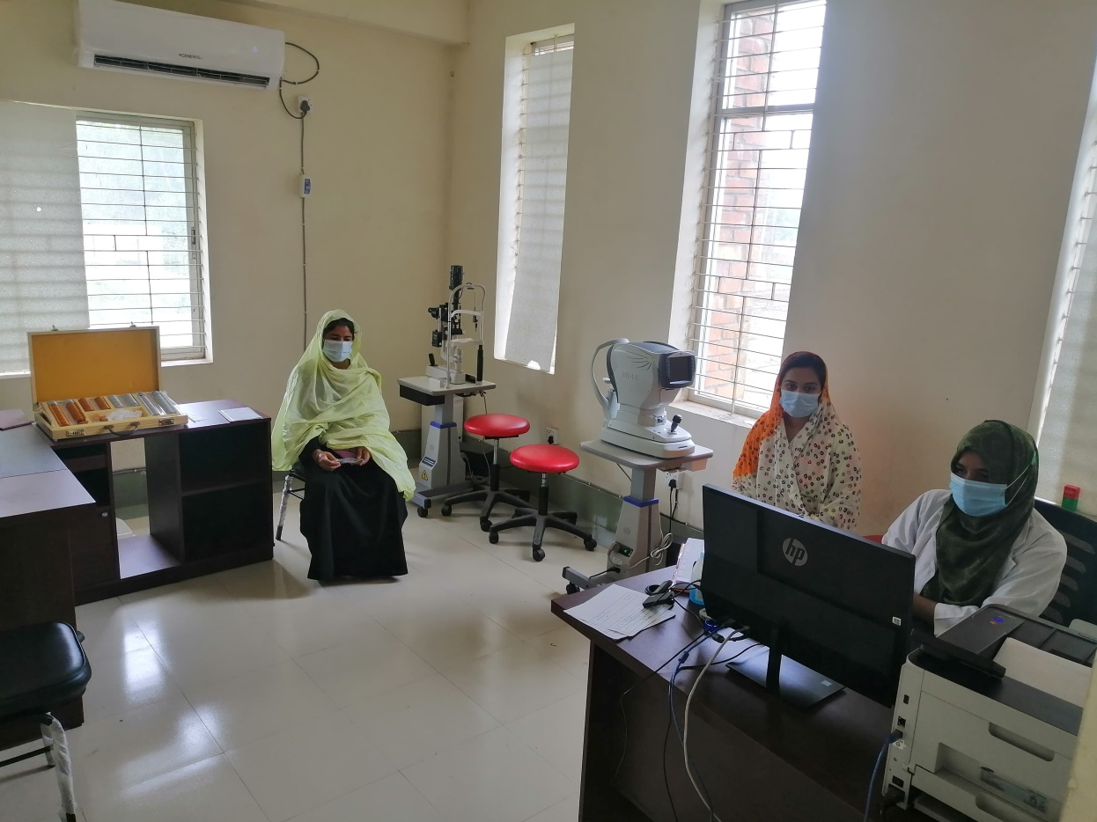
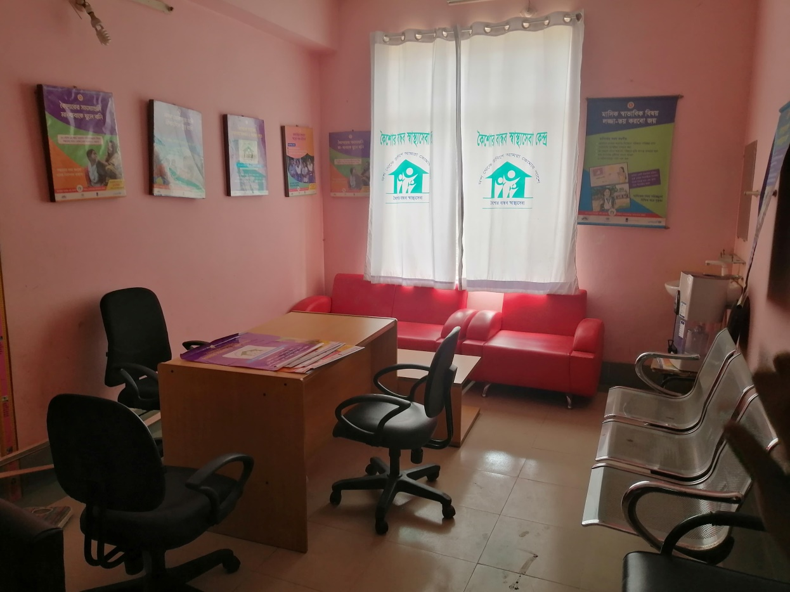
ADOHEART ROOM
COMMUNITY VISION CENTER

Slide 18
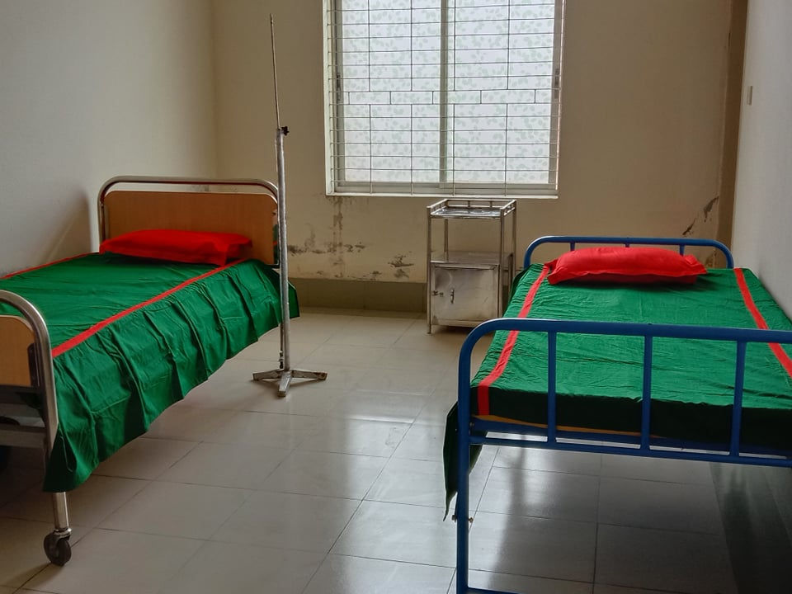
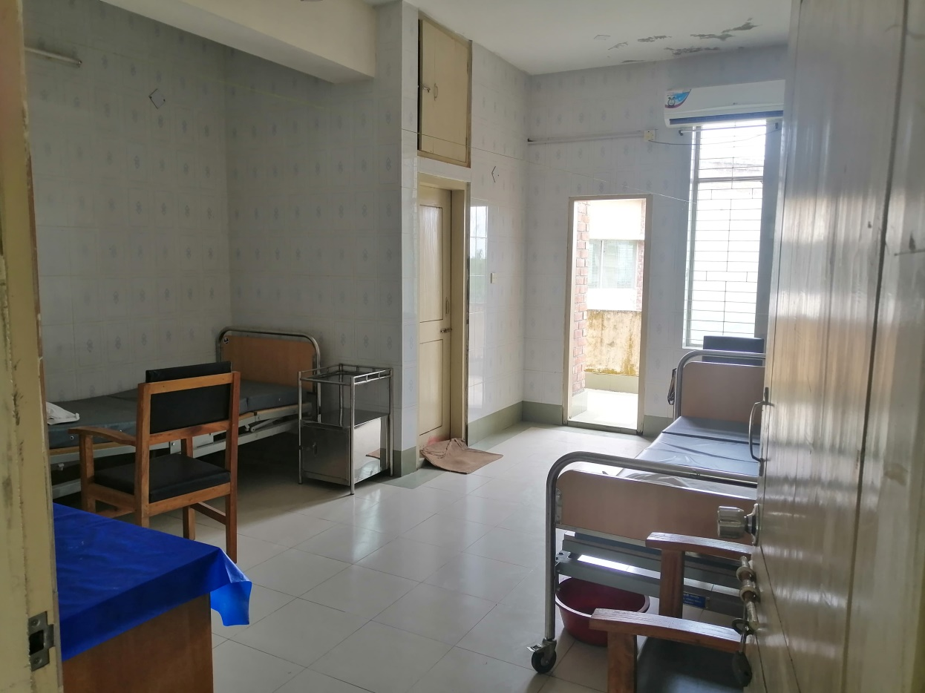
CABIN FOR FREEDOM FIGHTER
VIP CABIN

Slide 19
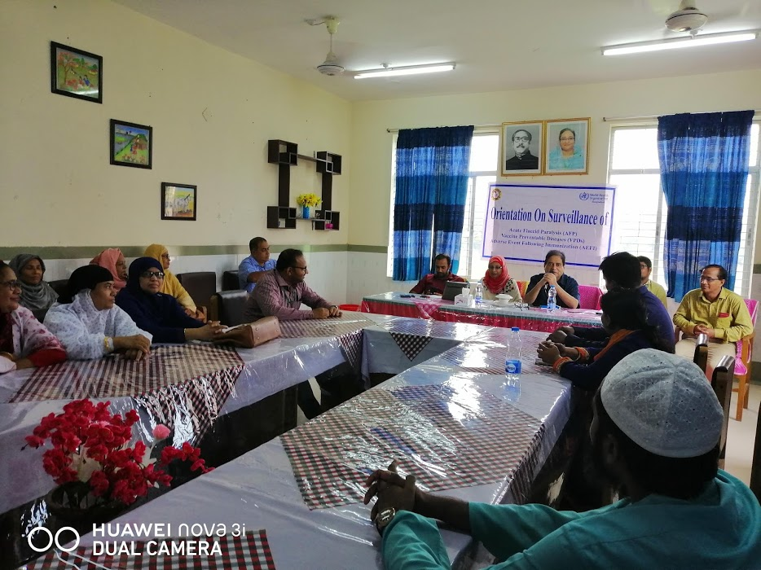
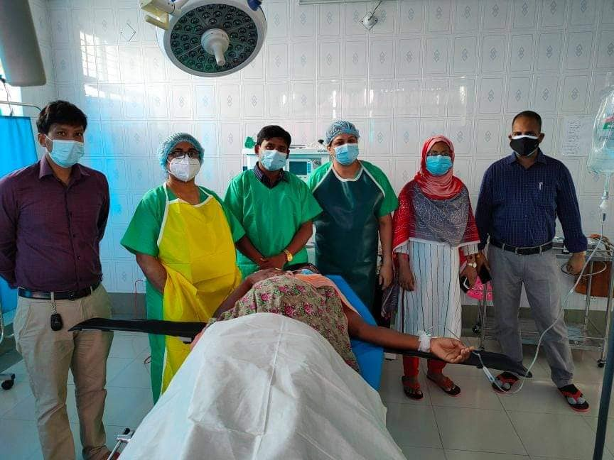
CONFERENCEROOM
OT COMPLEX

Slide 20
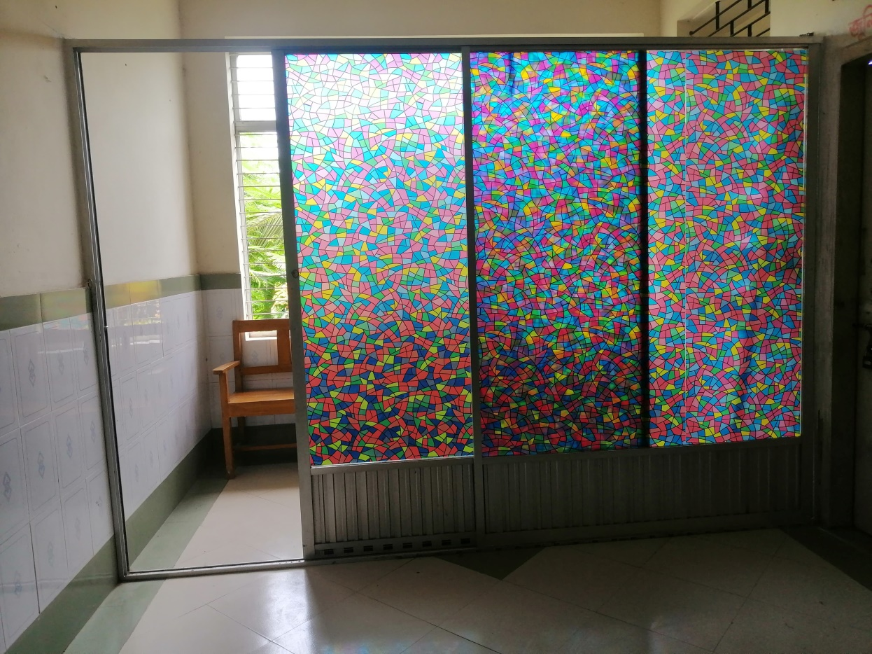
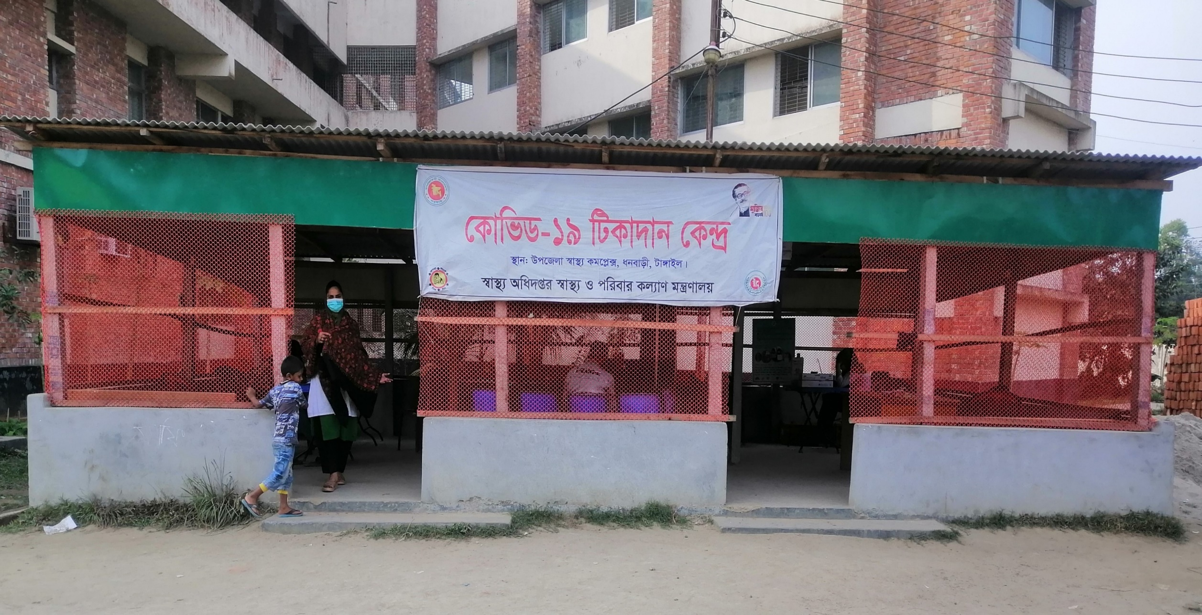
BREAST FEEDING ROOM
COVID-19 & EPI VACCINATION CENTER

Slide 21
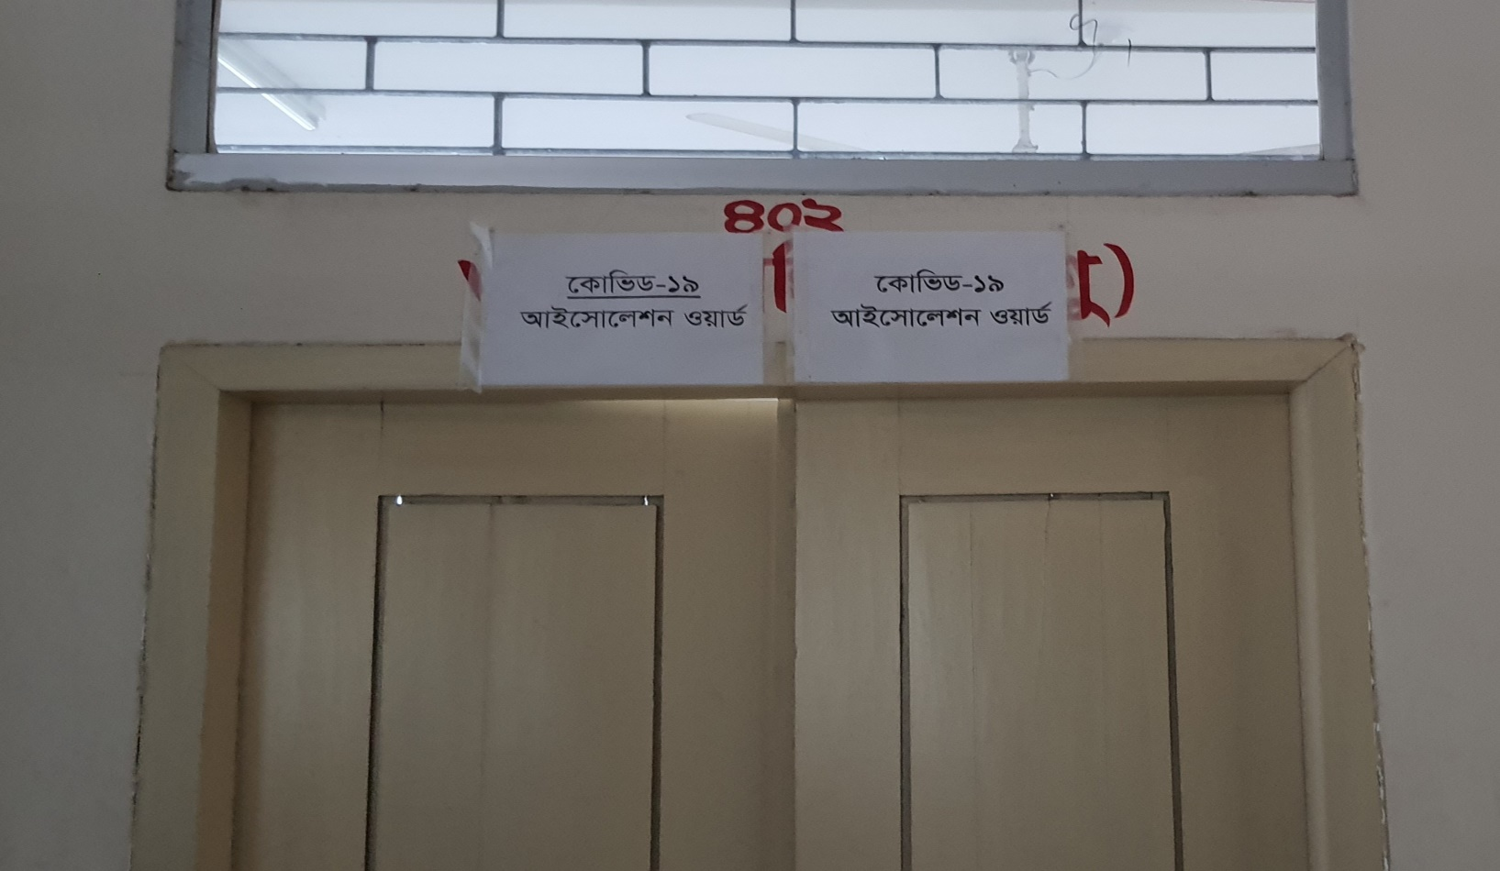
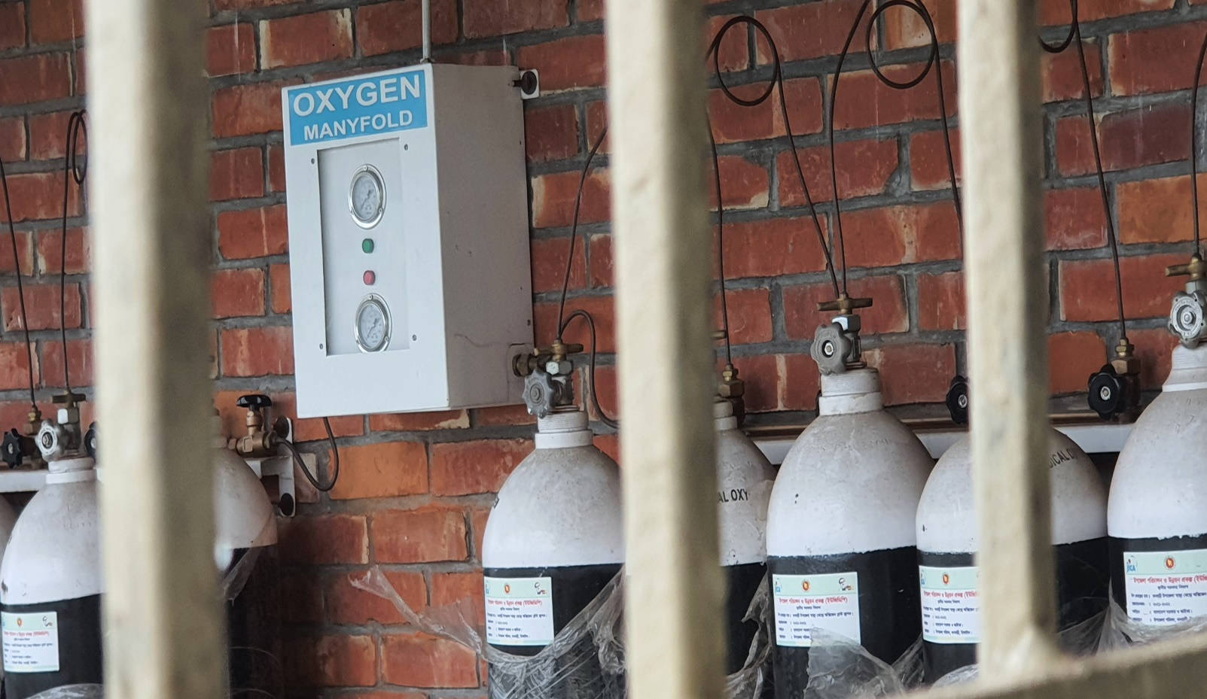
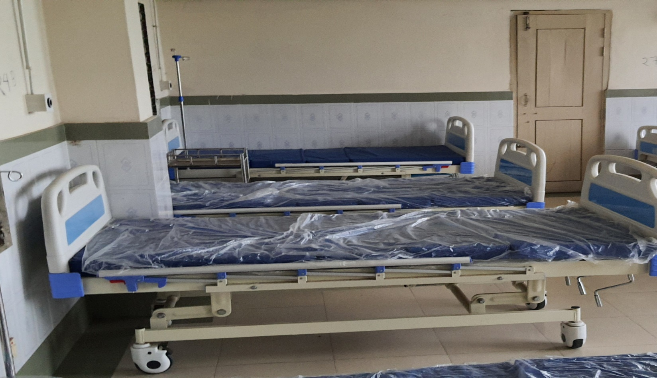
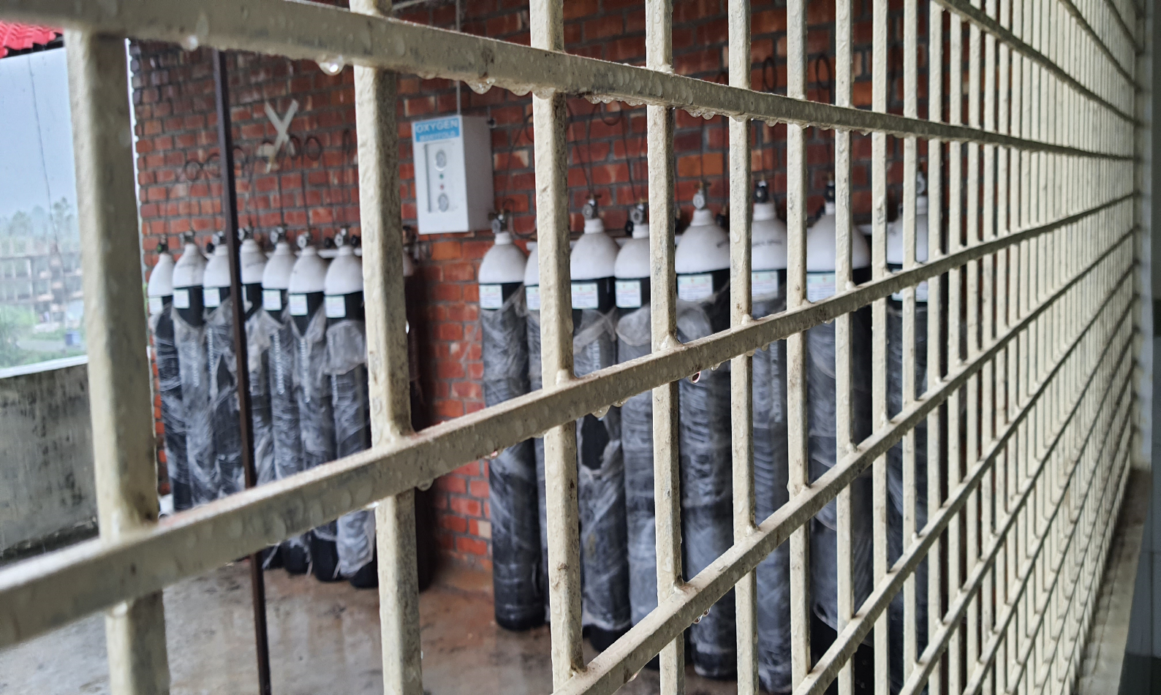
Measures for Covid-19 Patients

Slide 22
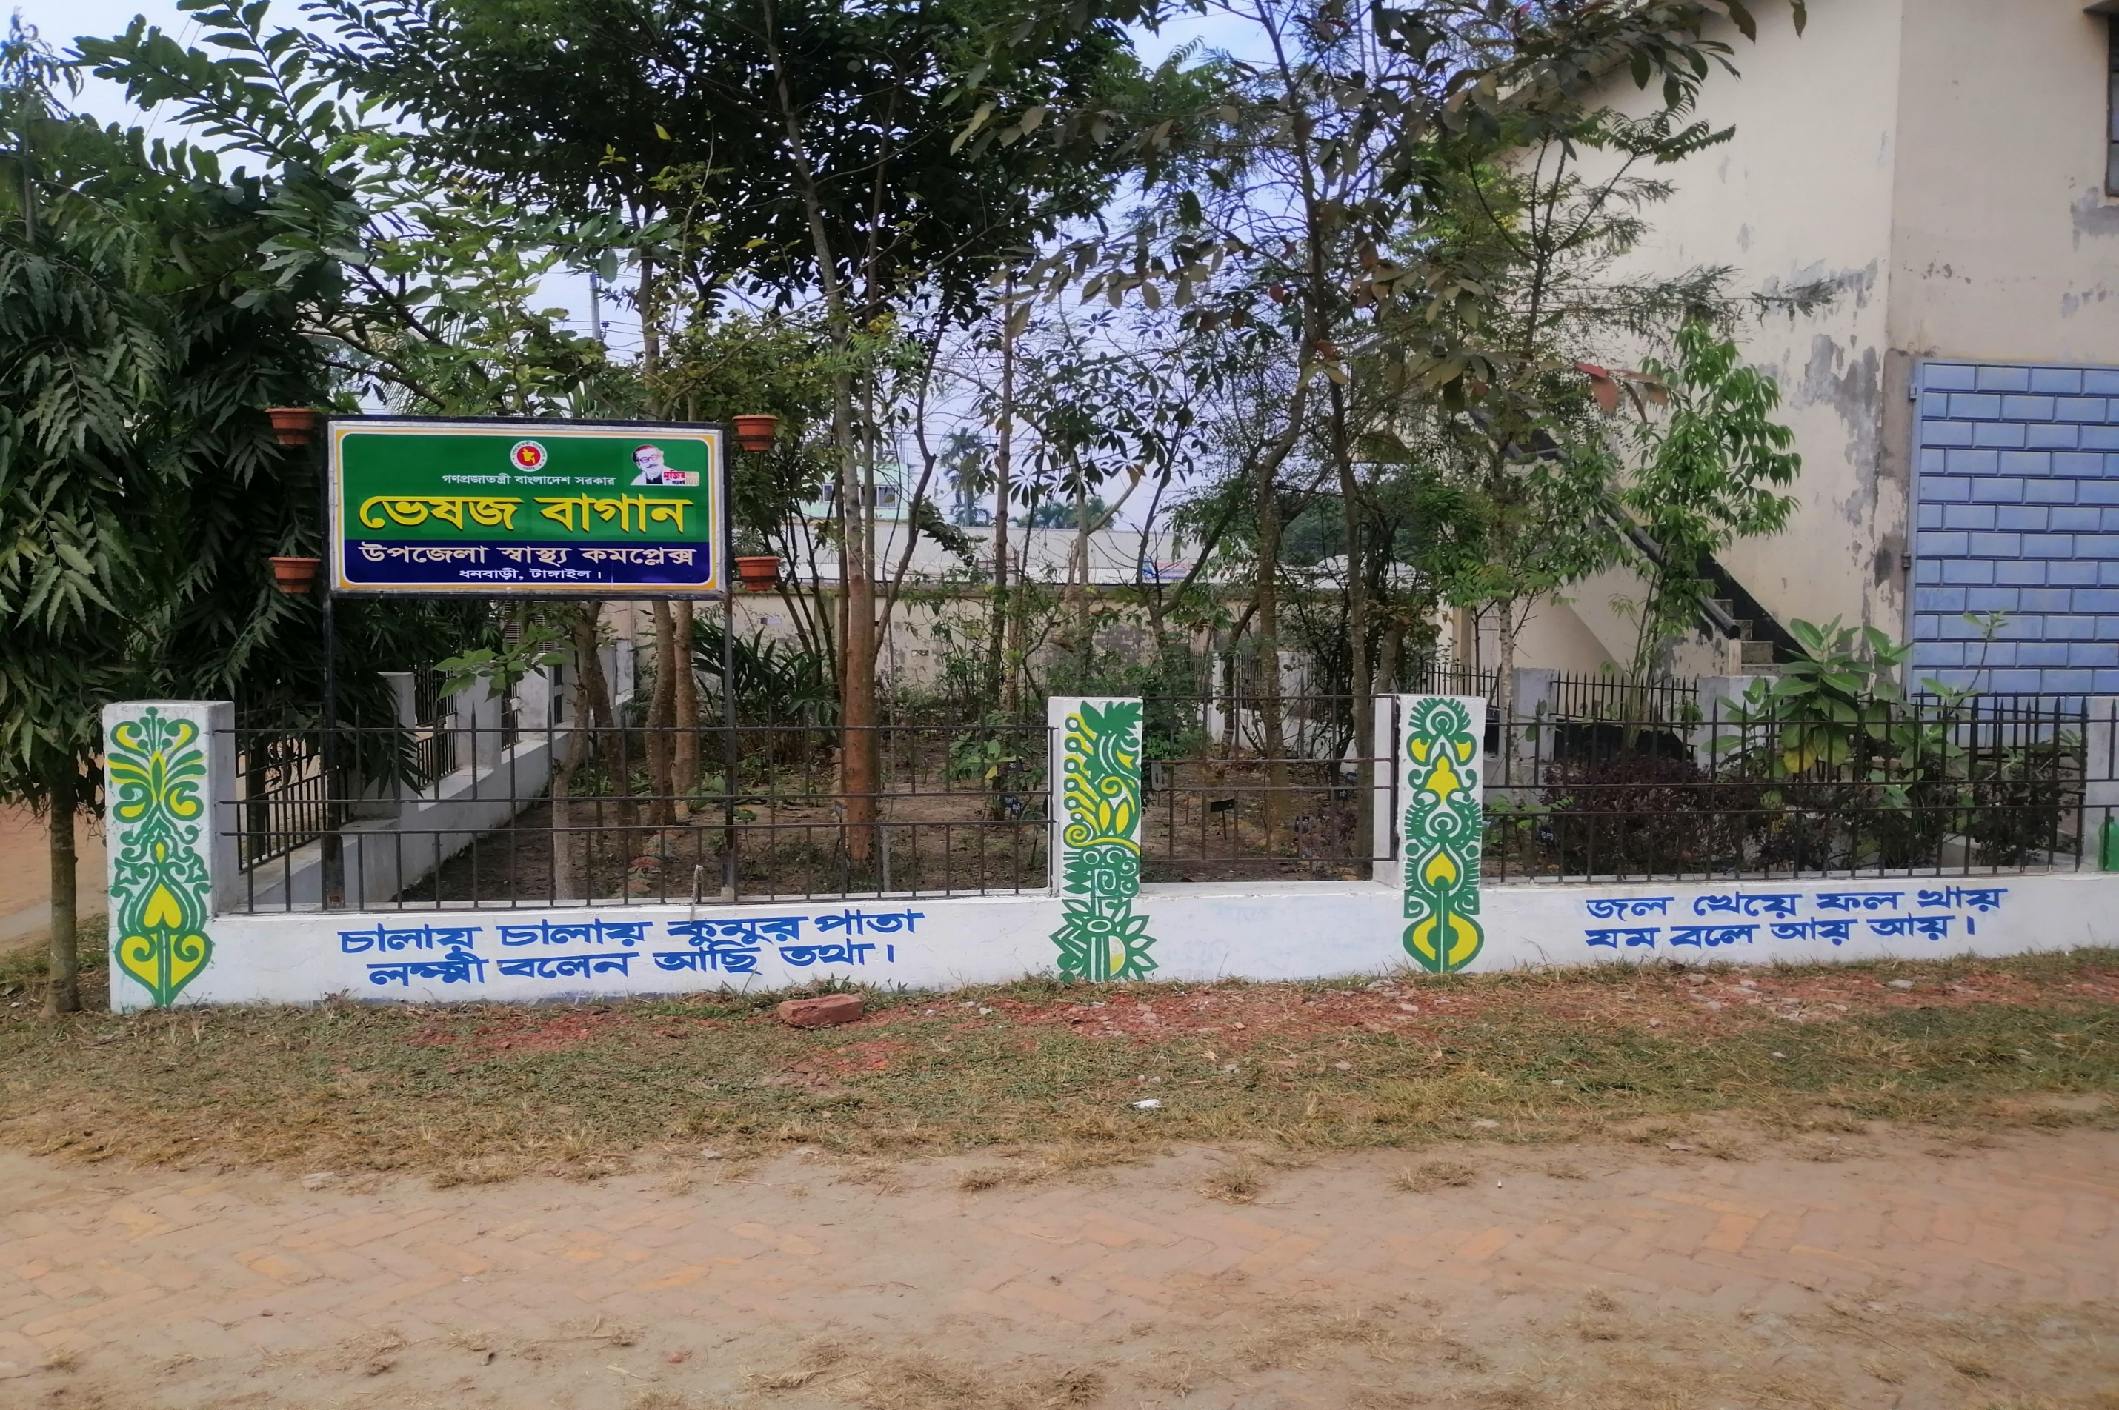
HERBAL GARDEN

Slide 23
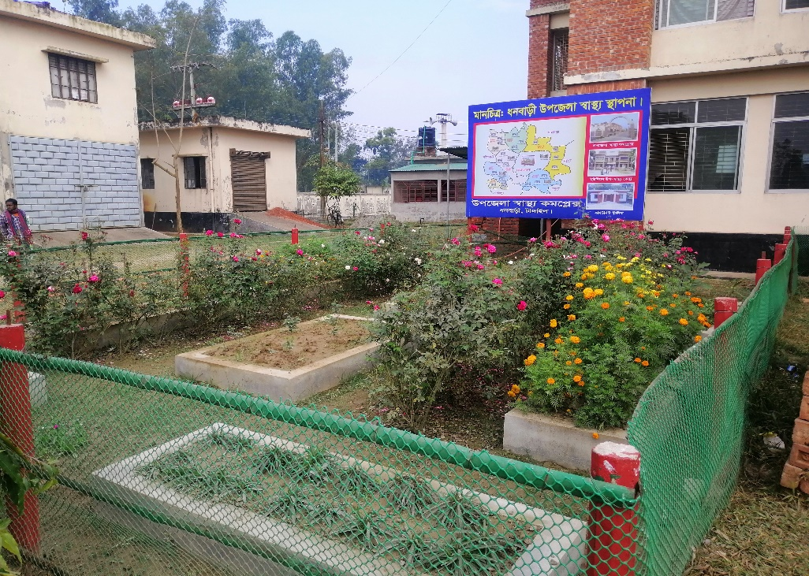
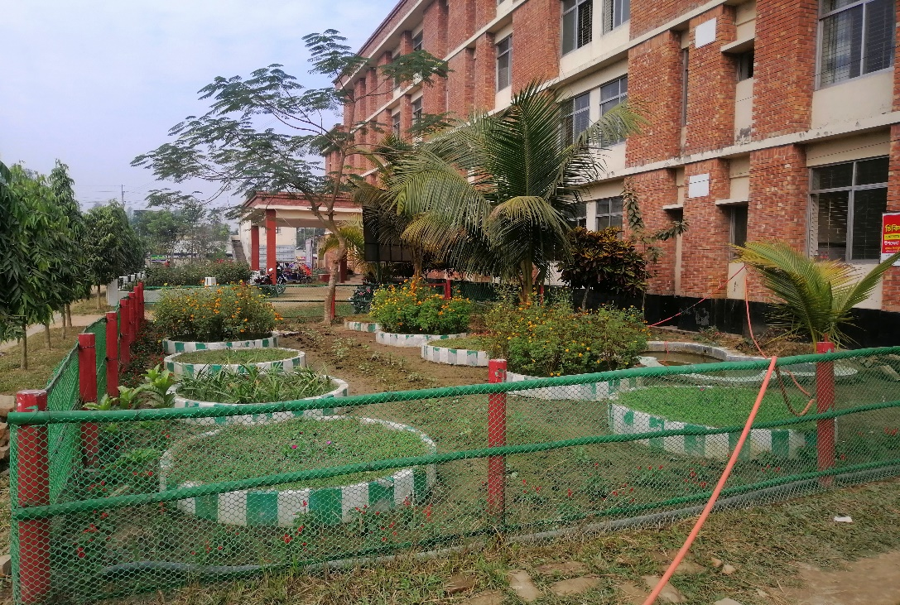
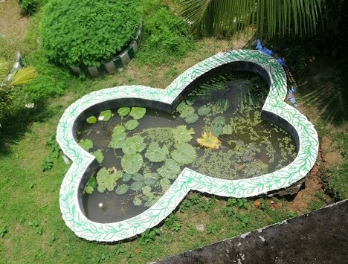
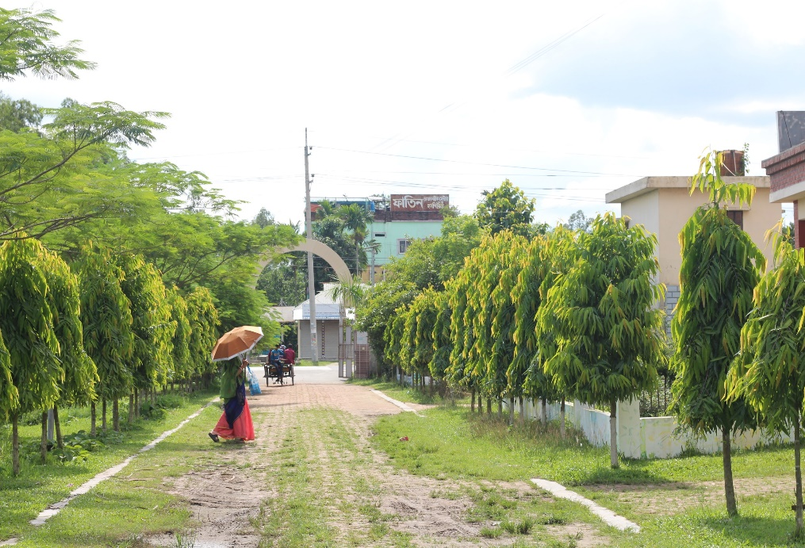
Beautification of the Campus

Slide 24
Challenges
Many of the Health Assistant Posts are vacant
Pediatric Consultant and other consultant posts vacant
Lack of pair of consultant gynaecologist and anesthetist residing at the hospital premises
Inadequate space for hospital store
Shortage of ward boy, ayah, other 4th class employees and field workers
No separate ward for diarrhea patients.

Slide 25
Way Forward…
Digital Ticketing System and Cash counter
Online patient database
Separate dinning space for walk-in patients and attendants
Library for the doctors
Regular Academic Sessions for the Doctors and nurses
Day care center for mothers working in this hospital

Slide 26
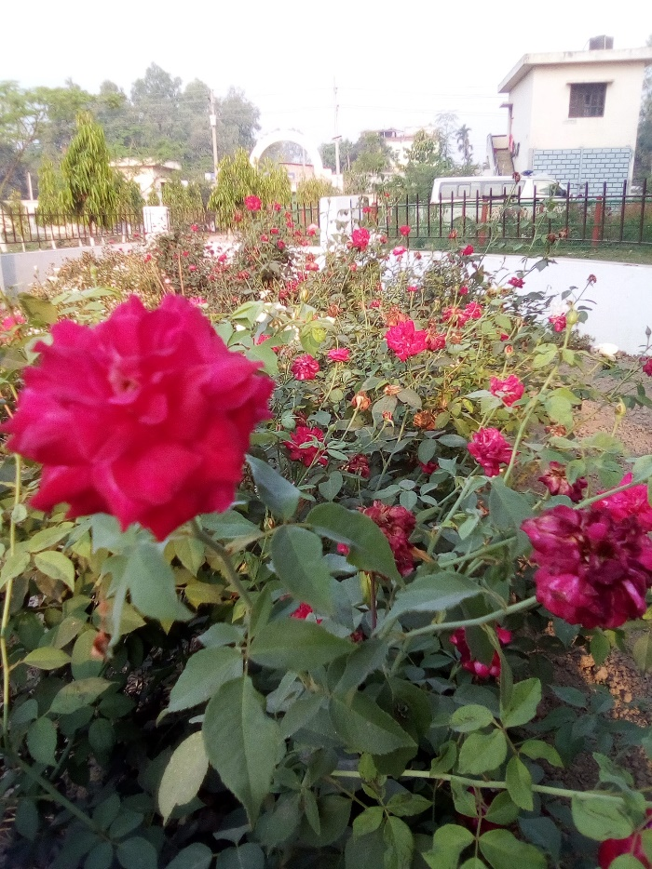
Thanks You

